Slide 1


AIL 411-DEEP LEARNING LAB
PREPARED BY: ASHA ROSE THOMAS
AP,CSE(AI),ASIET,KALADY

Slide 2
EXPERIMENT 7
Implement a simple RNN for review classification using IMDB dataset.

Slide 3
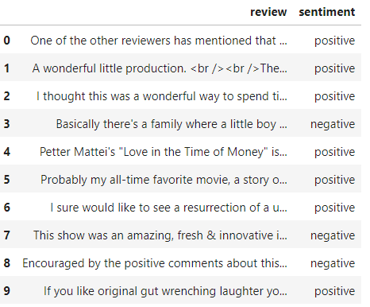
IMDB Dataset
This is a dataset for binary sentiment classification
Dataset Overview:
  25,000 movie reviews from IMDB
  Labeled by sentiment (positive/negative)
Sentiment Analysis (stanford.edu)
IMDB Dataset of 50K Movie Reviews (kaggle.com)

Slide 4
IMDB Dataset
tf.keras.datasets.imdb.load_data | TensorFlow v2.16.1

Slide 5
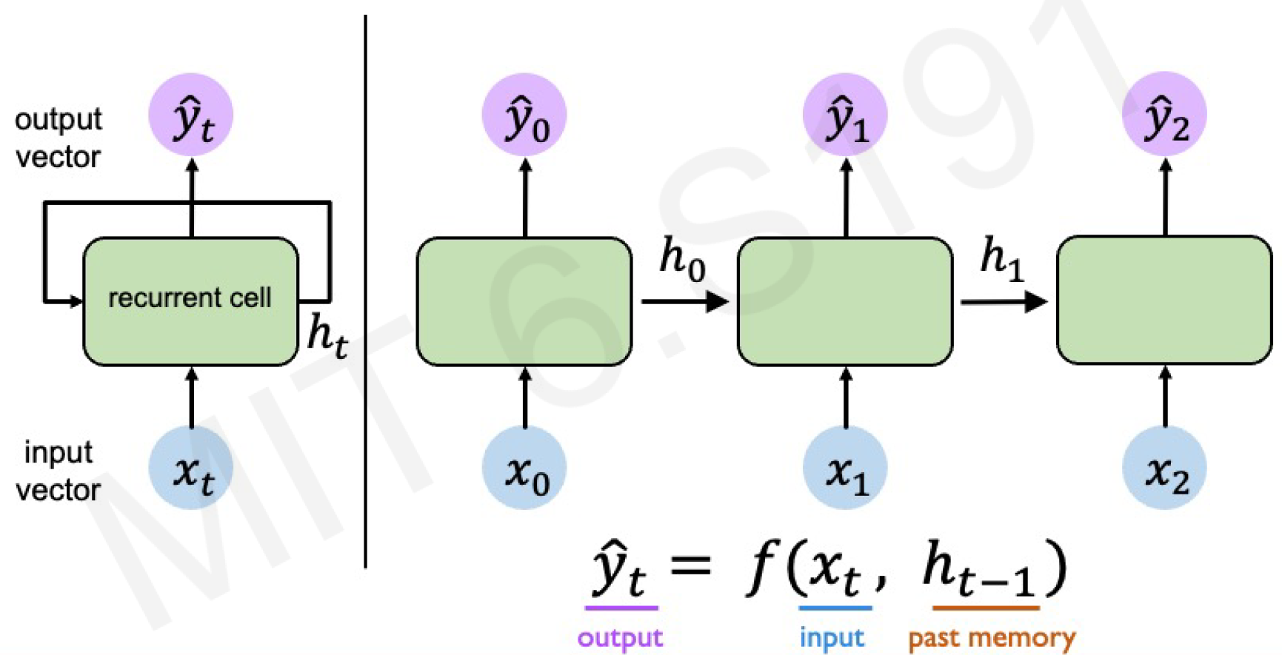
RNN - add immediate past to the present

Slide 6
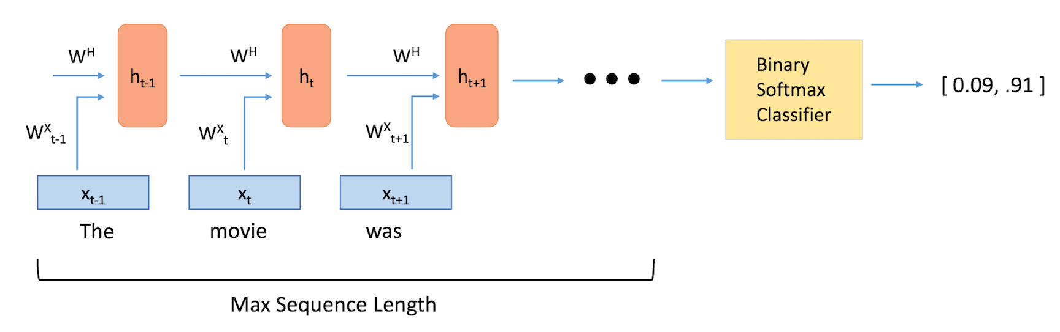
RNN Cell

Slide 7
Reference
Sentiment Analysis (stanford.edu)

